Slide 1
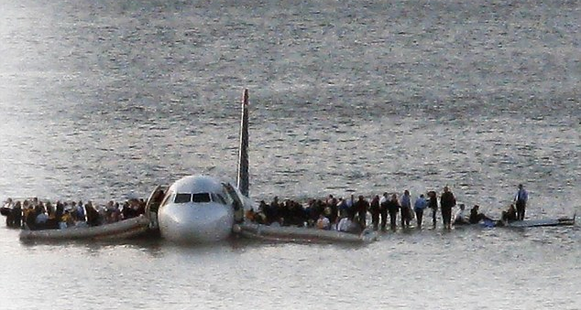
Miracle on the
Hudson

Slide 2
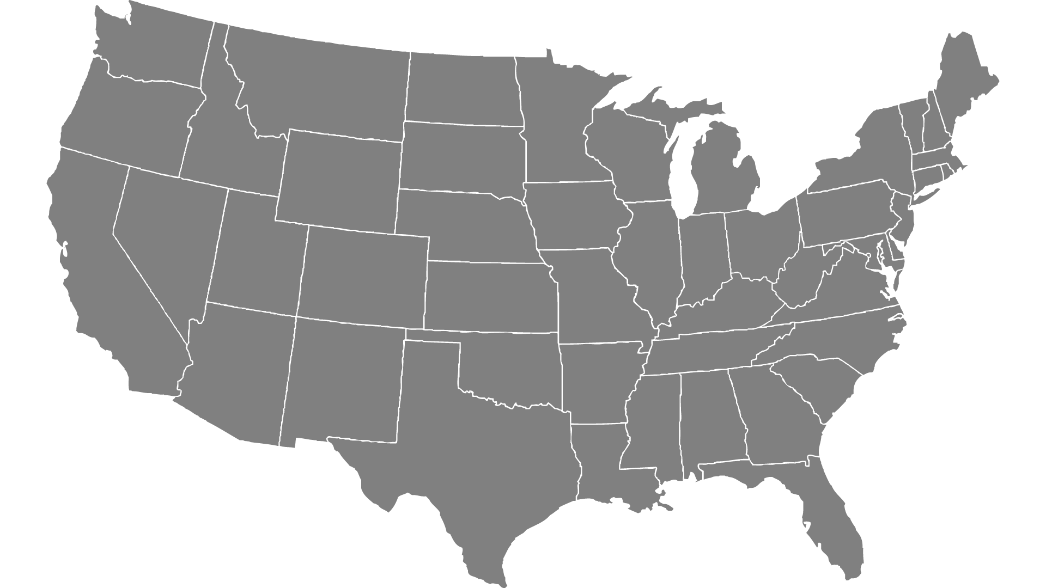



Aircraft Wildlife Strikes
By: Stuti Sharma Neena Sharma

Slide 3

Objective
To examine all the available factors contributing to the strikes.
To visualize the impact of wildlife strikes on wildlife species.

Slide 4

Our Story…………
Effect across Geography
Seasonality and Weather Effect
Impact on Flights
Cost Model

Slide 5

Data Review
Source
Data World
About
Wildlife Strikes by Aircrafts 2000-2011
Instances
25194
Attributes
26
Tool
Microsoft Power BI
Attributes
Airport_Name
Wildlife_NumberStruck
Effect_ImpactToFlight
Flight_Date
Aircraft_AirlineOperator
Origin_States
PhaseOfFlight
Wildlife_Size
Conditions_Precipitation
Conditions_Sky
Wildlife_Species
PilotWarned_Wildlife
Cost_Total$
Altitude_Bin

Slide 6
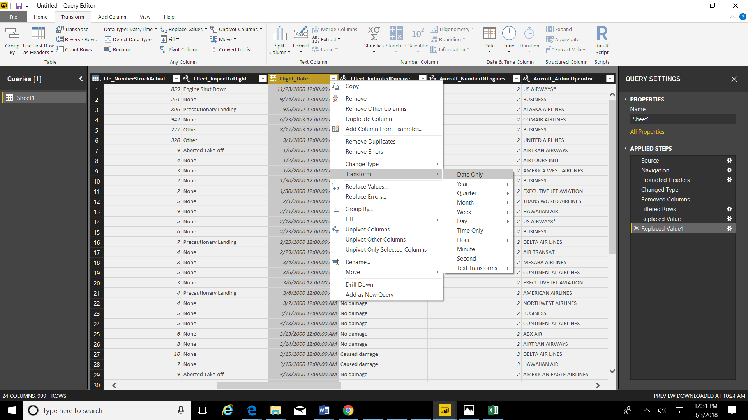
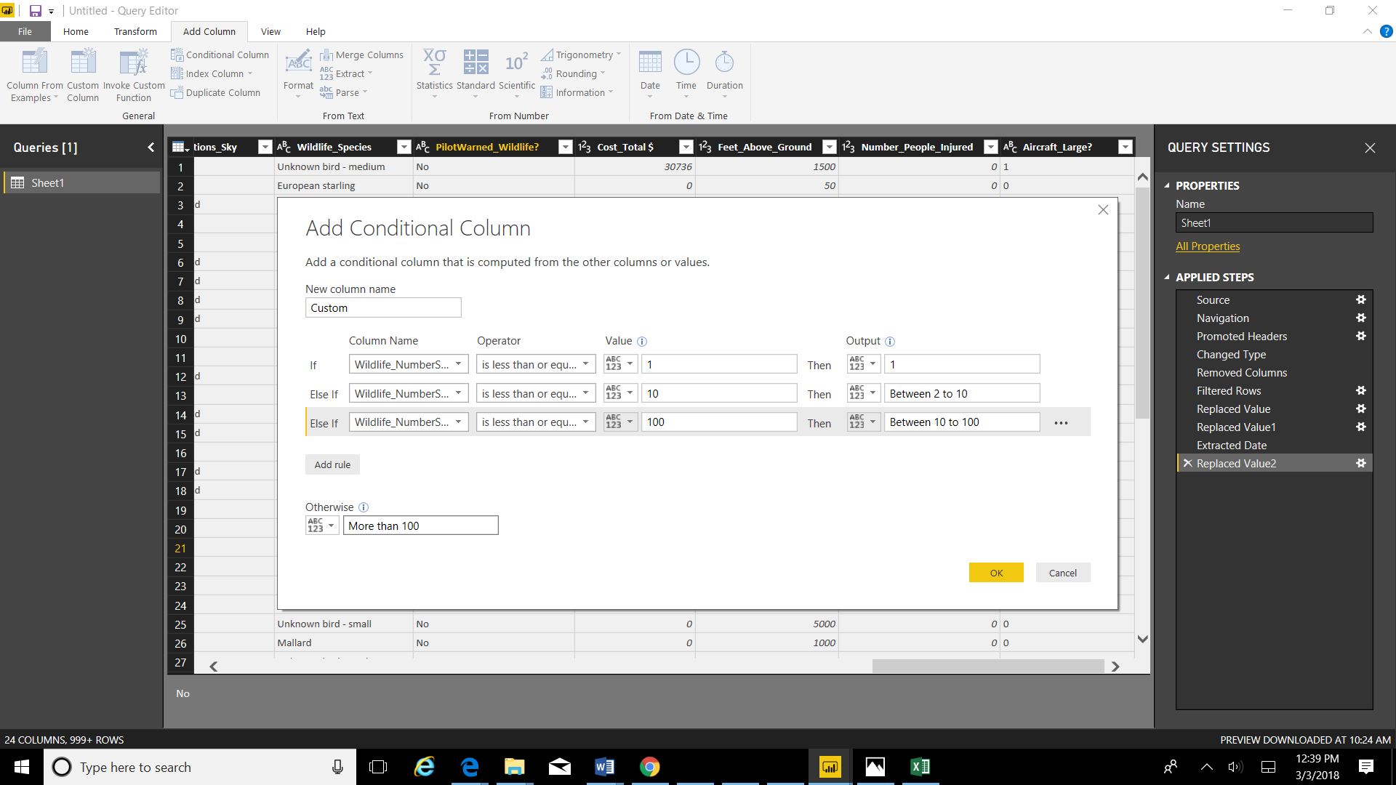
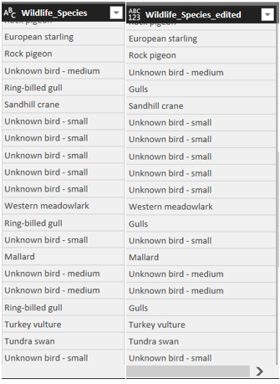
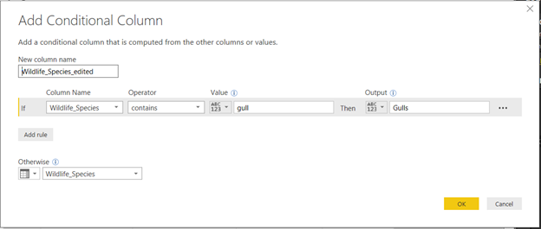
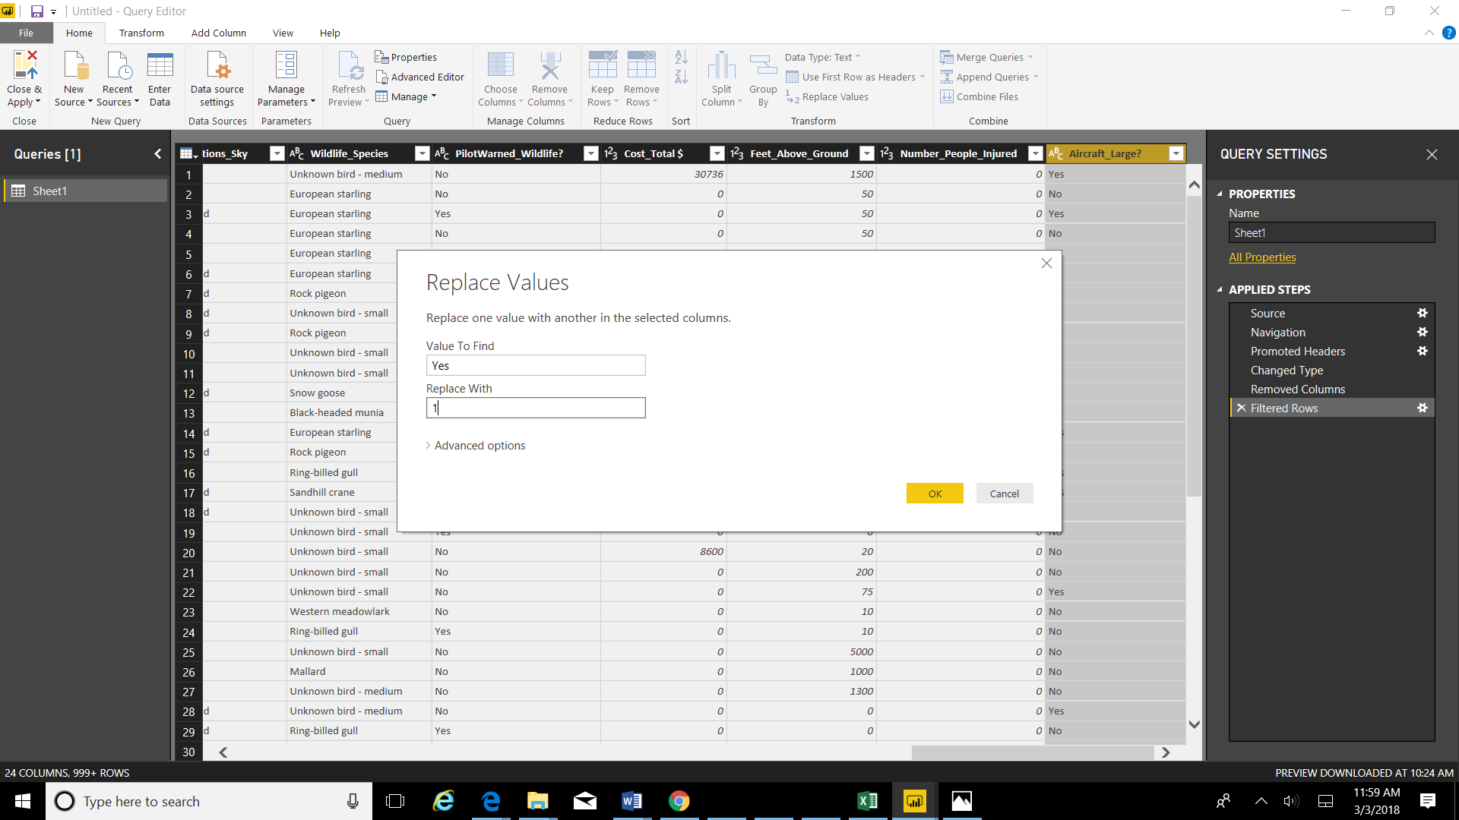
Data Preparation
Removed Irrelevant Attributes-Remarks
Removed Missing Values
Transformed Format
Calculation: Categorized Wildlife Strikes into Bins
Calculation: Grouped “Gulls” Species

Slide 7
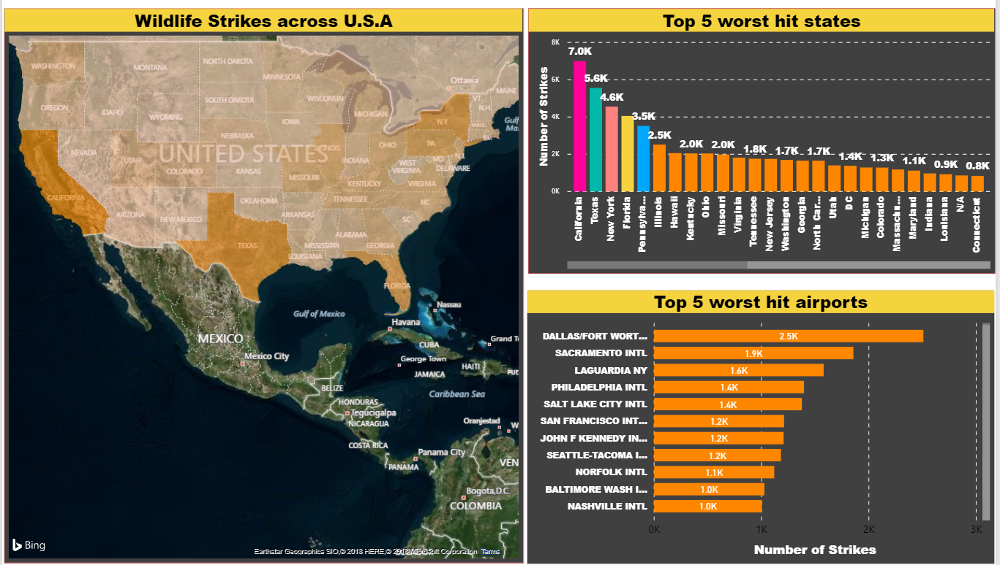

Geography
Ho: Costal Regions are more susceptible to strikes.

Slide 8
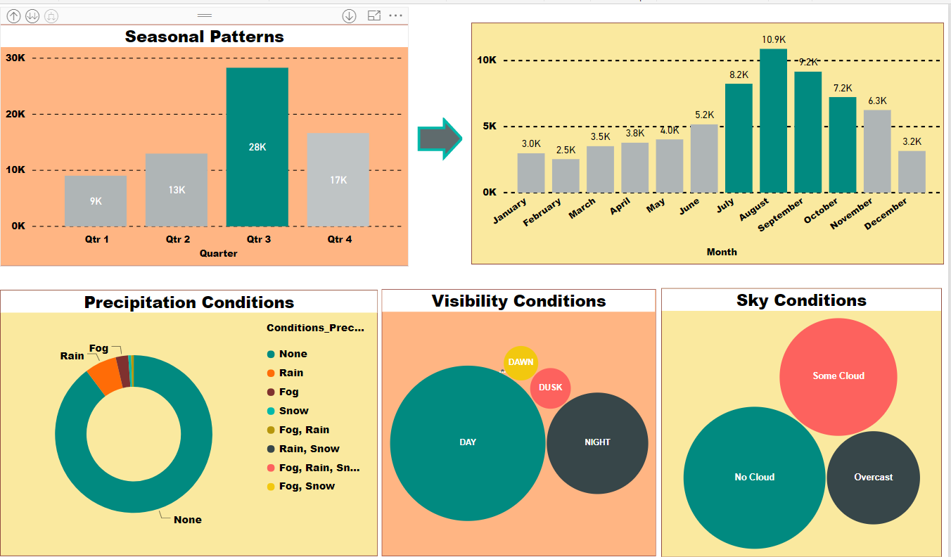

Ho: Number of strikes increases with decrease in Pilot’s visibility.

Slide 9
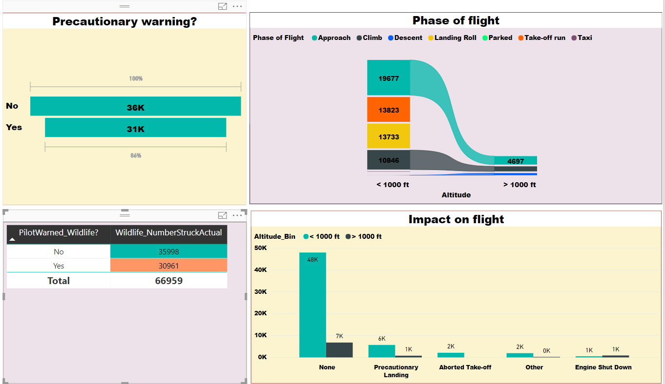
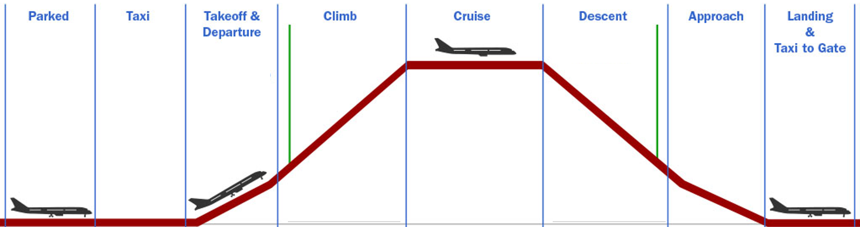
Ho: Warned Pilots are less susceptible to strikes.

Slide 10
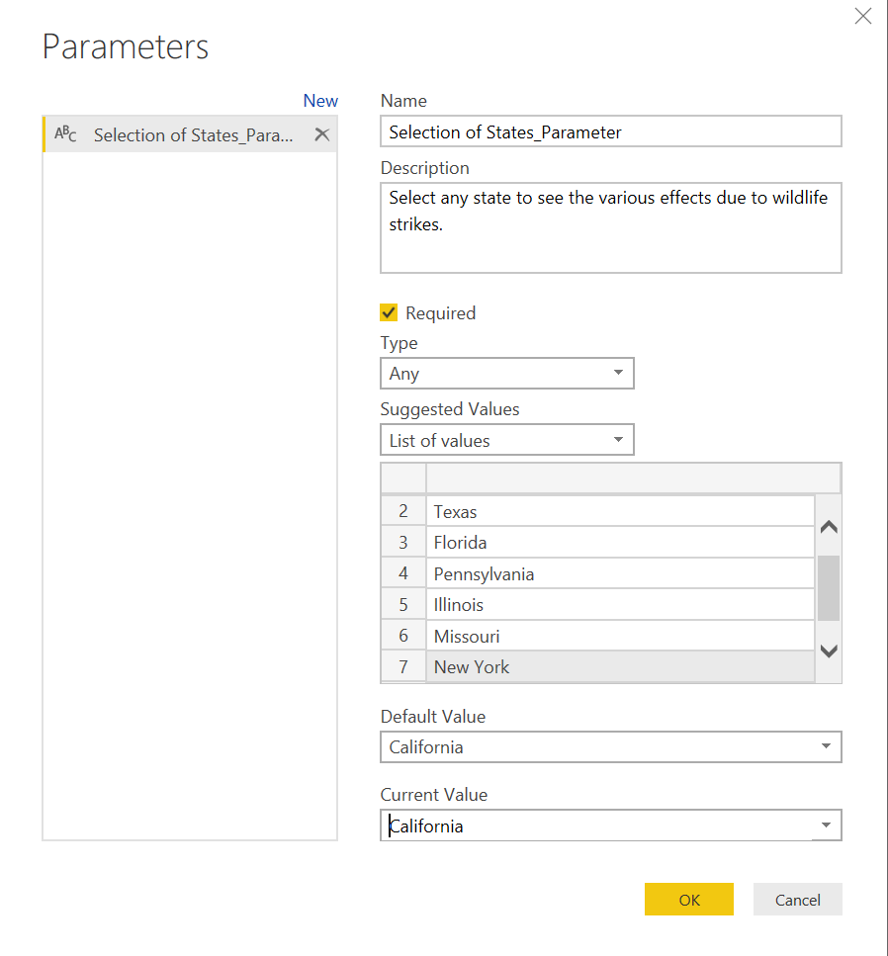
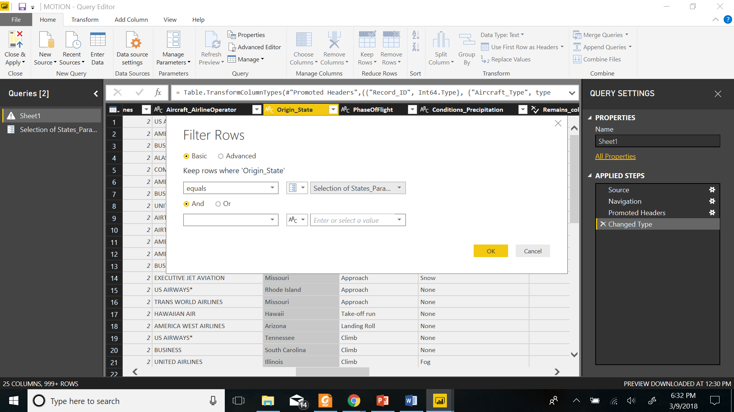
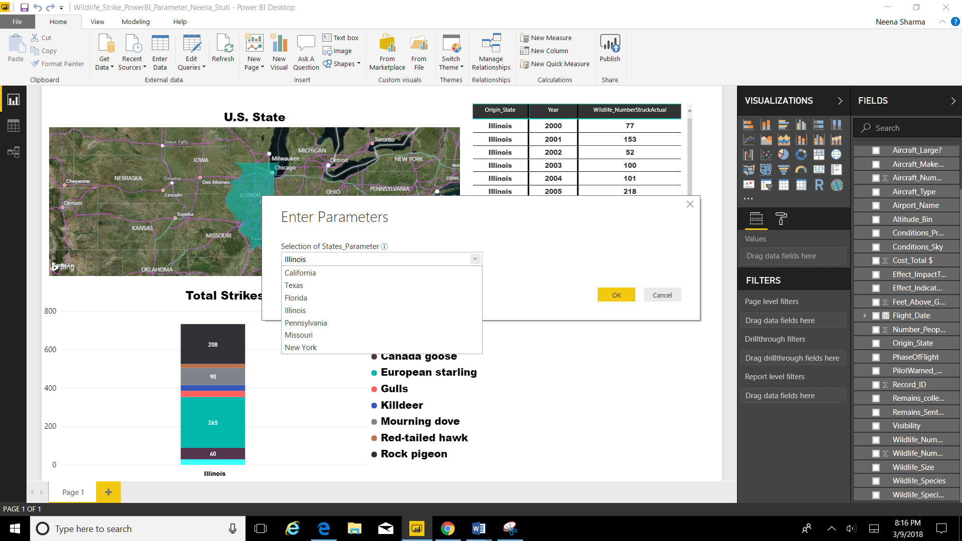

Slide 11
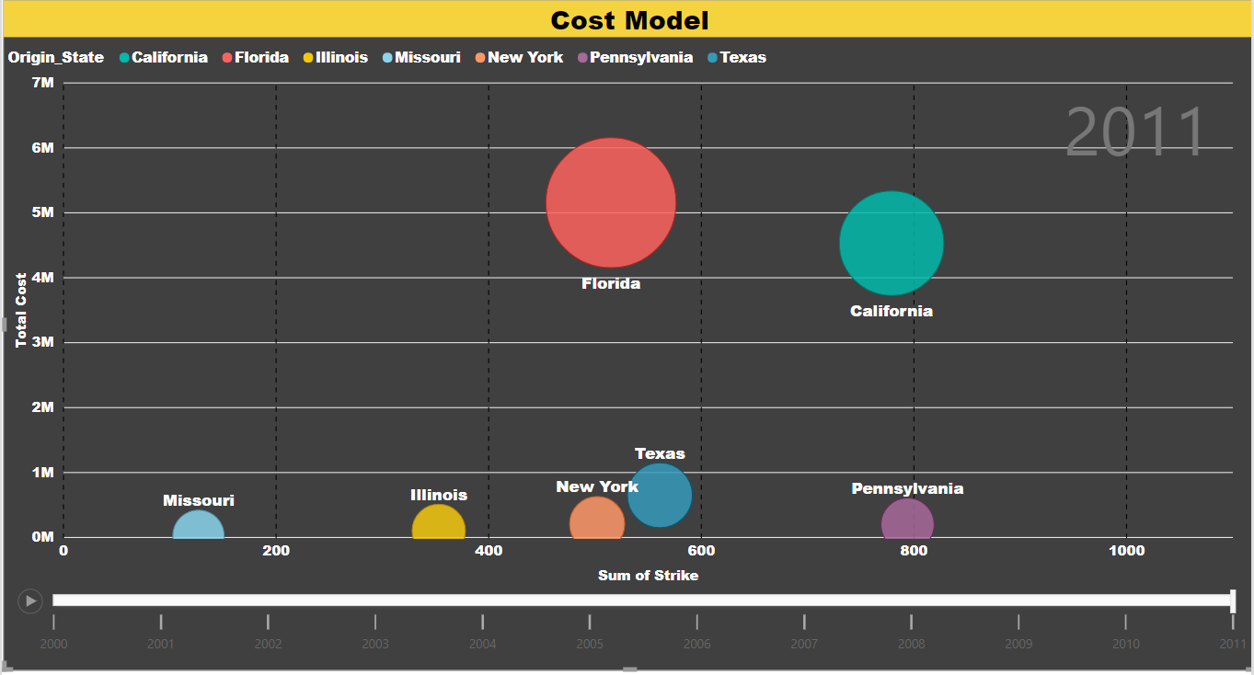
Measures
Total Cost
SUM(Sheet1[Cost_Total $])
Sum of Strikes
SUM(Sheet1[Wildlife_NumberStruck])
Average Cost per Strike
DIVIDE([Cost_Total $], [Sum of Strikes])
Configuration of Scatter Plot
Y axis: Total Cost per year
X axis: Sum of Strikes per year
Size: Average Cost per Strike
Legend: State
Play Axis: Flight Year
Motion- Cost Model

Slide 12
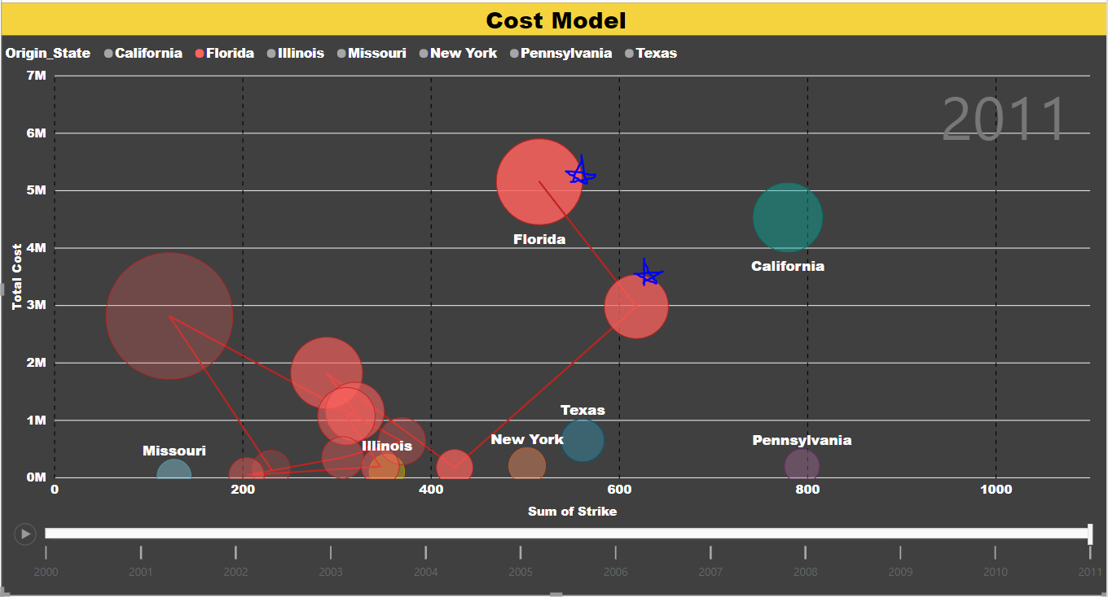
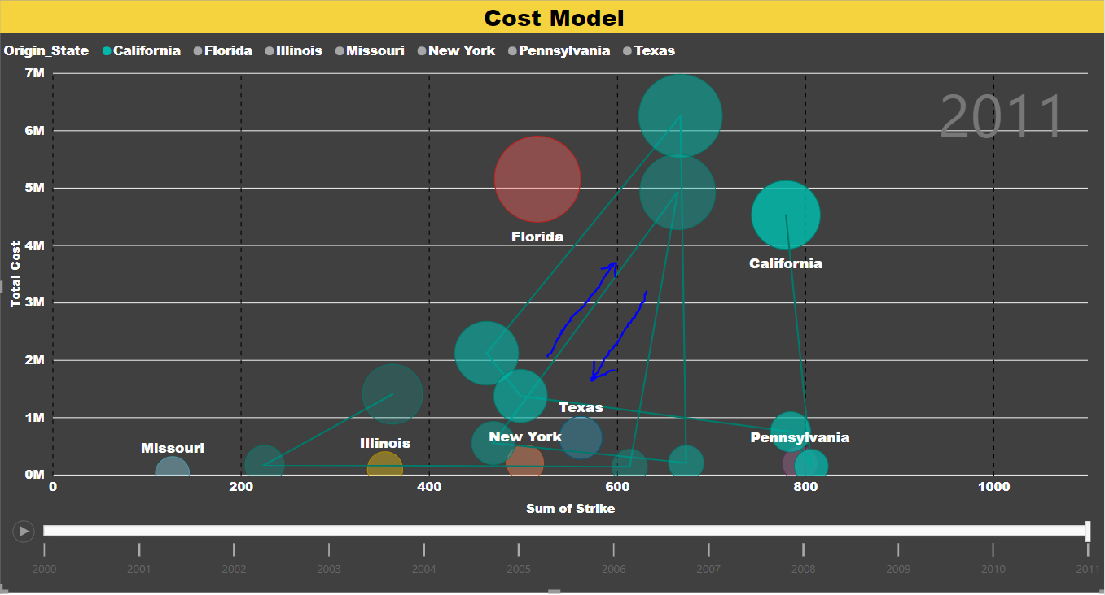
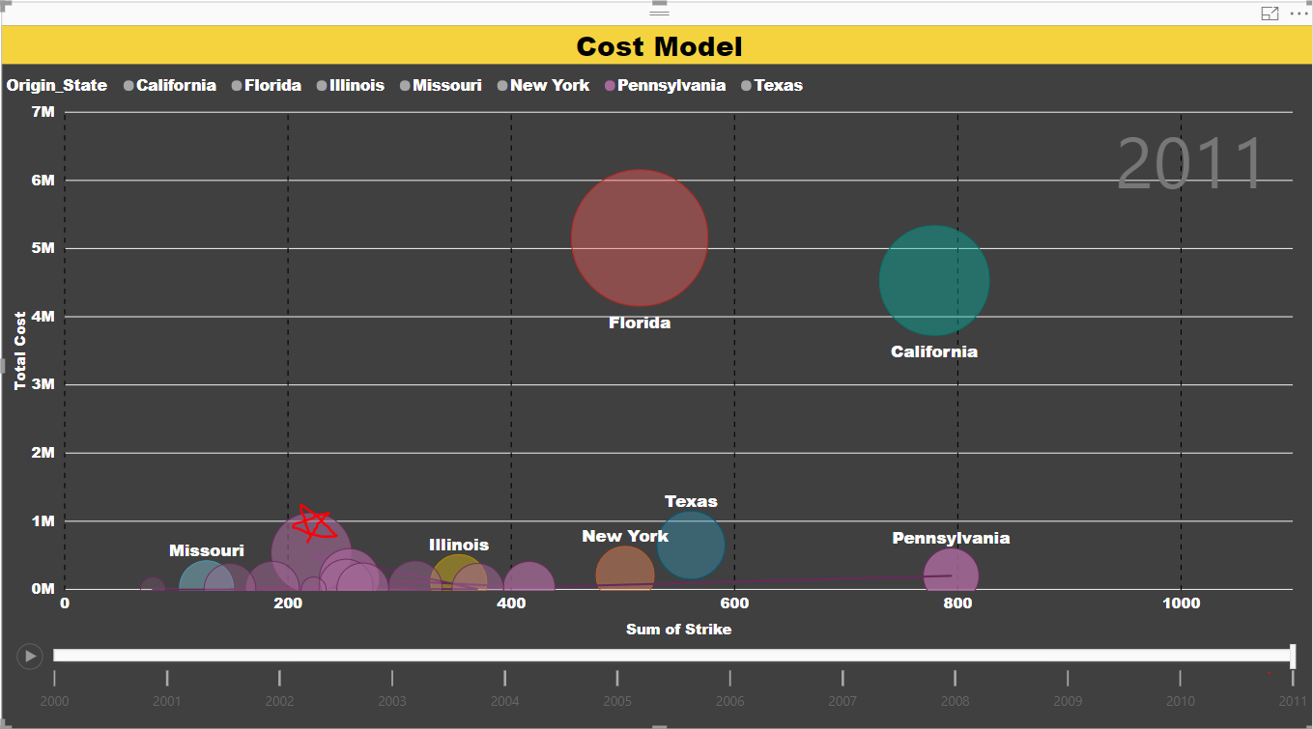
Florida 2010-2011: Sudden Increment in Cost.
California: Periodic increase in Cost & Strikes.
Pennsylvania 2007: Drastic increase in bubble size.

Slide 13

Airline Industry
Worst Hit Airport – Dallas, Sacramento, LaGuardia
Worst Hit State – California with 10% of strikes
Worst Hit Airline Operator – Southwest, American & Delta
Worst Hit Phase of Flight – Approach with 37% of strikes
Use Cases
Environmentalists
Total Strikes - 66959
Worst Hit Species – European Starlings, Rock Pigeons & Gulls

Slide 14
What went well
Cleaned dataset
Basic functionalities were User friendly-Motion.
Referred to plenty of YouTube tutorials and peer-reviewed articles
Good team work
What Did NOT go Well
Power BI freezing moments ☹
Limited Measures
Complex sharing of Query Parameter.
No Story option
Unavailability of interactive PowerPoints.
Data Limitation: Voluntary Reporting System.
Next Time
Migration Trend analysis.
Population Vs. Strikes rates analysis.
Aircraft models Vs. Strikes analysis.
Will use laptop with <16Gb RAM & i7 core.

Slide 15


